Slide 1

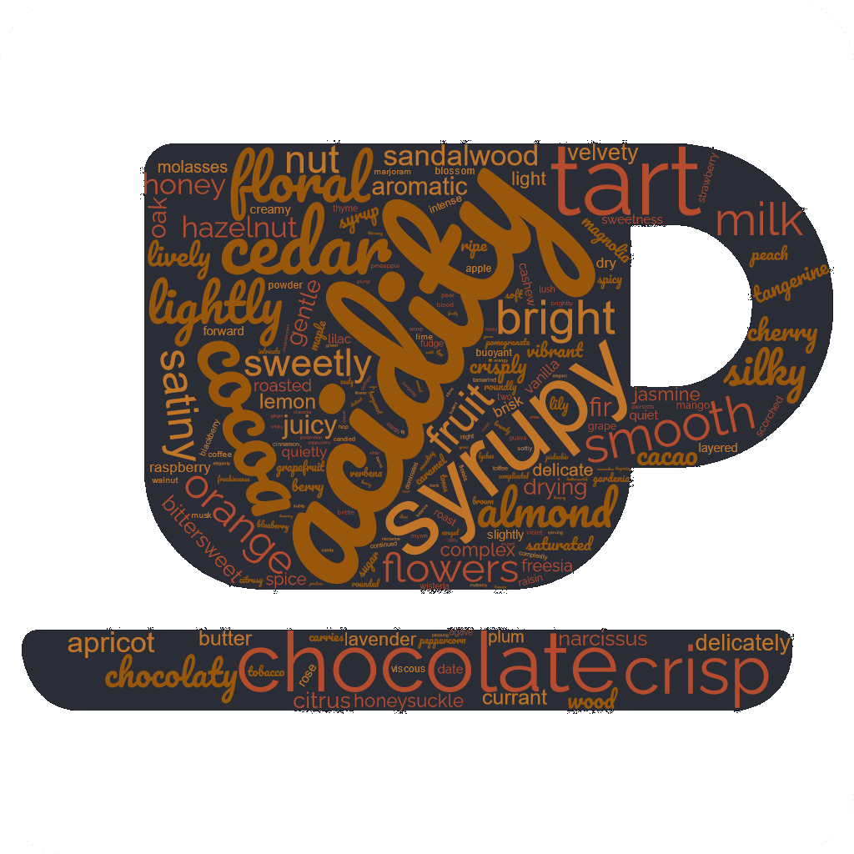
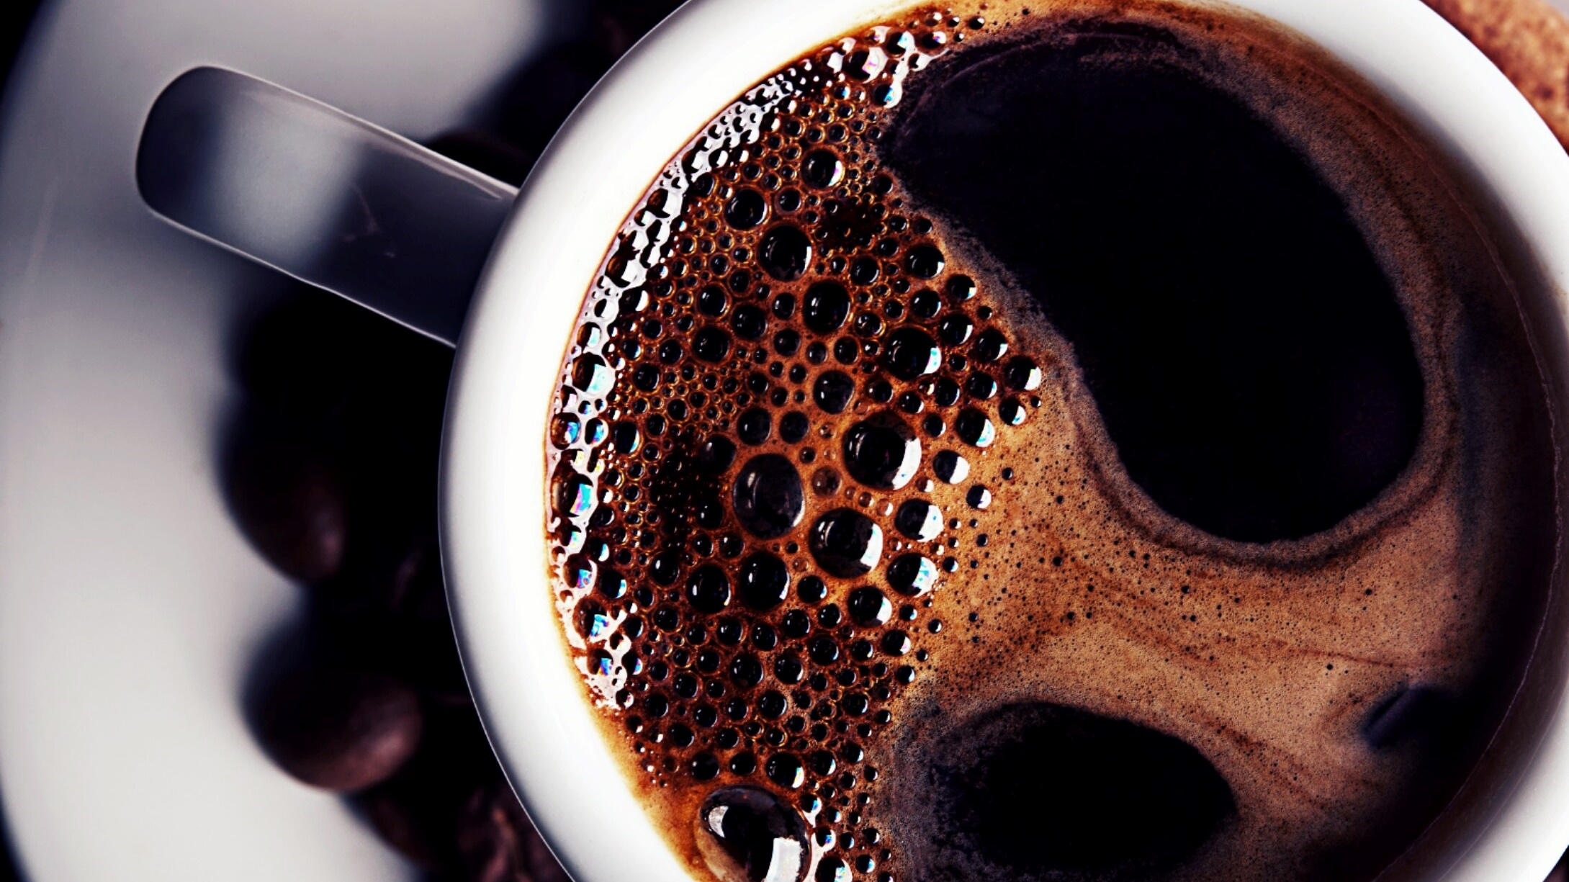
CoffeeCompass
CoffeeCompass
Final project by David Guillet and Laurens Duin
Ironhack DAFT JAN2023
Notes:
David
We introduce you today to our coffee recommender, the CoffeeCompass!

Slide 2
Finding good coffee can be challenging
CoffeeCompass
Plenty of coffees around with huge range of characteristics and flavour profiles
Lack of time and energy to compare
How to recognize a good coffee and what to look for
Getting the highest quality for the most affordable price
Notes:
David
Opening / PAIND POINTS
We introduce you today to our coffee recommender, the CoffeeCompass!
Why Coffee?
Because coffee is everywhere, a confort, a need, smtme addiction. But a fantastic source of productivity
- How to recognize a good coffee and what to look for
Plenty of coffee and Range of characteristic and flavor profiles
Could be a Lack of time or energy to compare all of them, OR SIMPLY not the proper tool
Highest Quality Most affordable price

Slide 3
Many challenges, one solution: CoffeeCompass Different options available:
CoffeeCompass
Random suggestion:
You’re feeling adventurous.
CoffeeCompass suggests a completely random coffee.
01
Top five best or budget:
You either have or don’t have a lot of disposable income.
CoffeeCompass provides a top five coffees based on the highest rating or lowest price.
02
Custom selection:
You’re a connoisseur.
CoffeeCompass asks you for some inputs and recommends a coffee based on the provided information.
03
Notes:
David
Many challenges, in one solution:
To achieve this quest
CoffeeCompass will GUIDE you through 3 different options
1 – You feel adventurous
It suggests you a completely random coffee.
2 - You either have or don’t have a lot of disposable income.
It will provides a top five coffees based on the highest rating among the lowest price.
3 – You’re a connoisseur.
CoffeeCompass asks you for some inputs and recommends a coffee based on the provided information

Slide 4
CoffeeCompass provides succinct information on the selected coffee(s)
CoffeeCompass
Information provided by CoffeeCompass includes:
Coffee name
Roaster & location
Roast type
Origin
Price
Overall rating (scale 50-100)
Points awarded for aroma, body, flavour and aftertaste (scale 1-10)
The results of the blind assessment
The underlying database with 4929 reviews are from coffeereview.com
Notes:
Laurens
Coffee Review introduced the first-ever 100-point
20-plus years
Review by coffee experts

Slide 5
Option 3 – Custom selection
CoffeeCompass
The coffees were clustered with Machine Learning based on the following features: aroma, body, flavor, aftertaste, rating.
Natural Language Processing was used to extract the words most often mentioned in the blind assessments of the coffee reviews. These were then used to create groups of characteristics.
Notes:
Machine Learning: Laurens
Natural Language Processing: David
Jupyter Notebook: Laurens
Show following:
Option 1
Option 2 (only the top five price)
Option 3 (ask audience for characteristic)

